Slide 1





User-defined functions, procedures and triggers, Transactions
Databases
Basics
SoftUni Team
Technical Trainers
Software University
http://softuni.bg

Slide 2
Questions
sli.do #5604

Slide 3

Table of Contents
Transactions
Functions
Procedures
Triggers

Slide 4

Functions

Slide 5

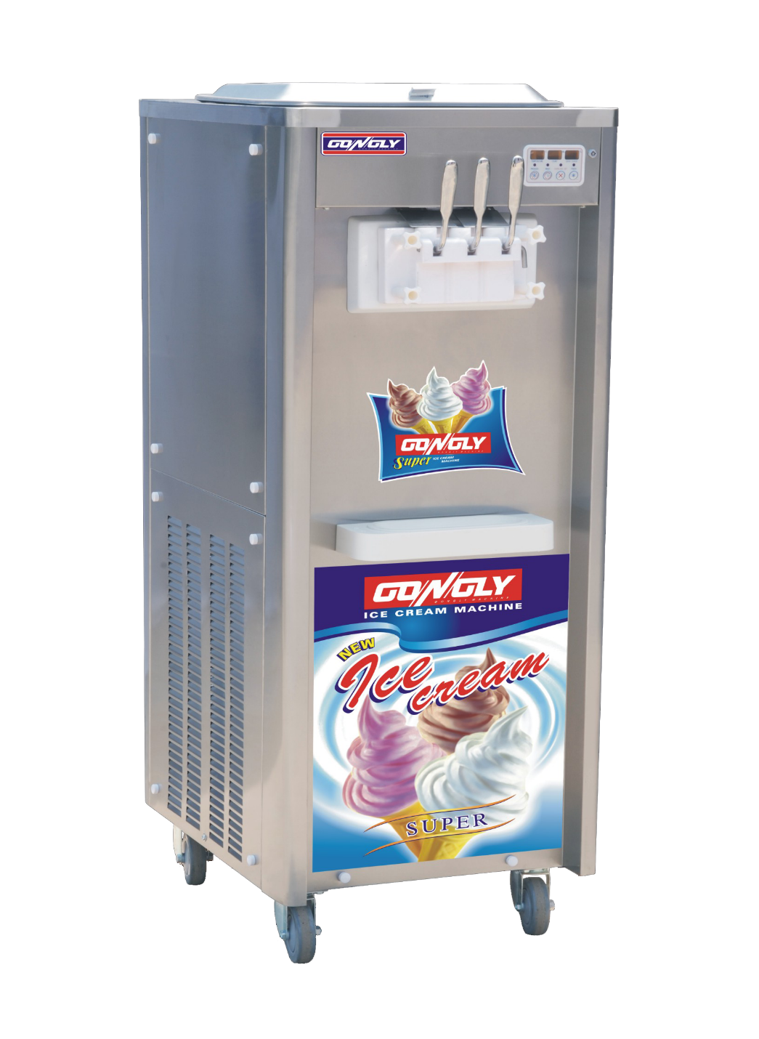





Functions Basics

Slide 6
Functions Basics
Algorithm that always returns a value/values
Can accept parameters
Can be nested

Slide 7
SQL Server – Create Functions Setup
Projects
ProjectID | StartDate | EndDate
1 | 2016-09-01 | 2016-10-07
2 | 2016-10-01 | 2016-10-07
3 | 2015-10-07 | NULL

Slide 8
SQL Server – Create Functions
CREATE FUNCTION udf_ProjectDurationWeeks (@StartDate DATETIME, @EndDate DATETIME)
RETURNS INT
AS
BEGIN
DECLARE @projectWeeks INT;
IF(@EndDate IS NULL)
BEGIN
SET @EndDate = GETDATE()
END
SET @projectWeeks = DATEDIFF(WEEK, @StartDate, @EndDate)
RETURN @projectWeeks;
END
Function Name
Parameters
Return Value
Variable
IF Statement
Return result

Slide 9
SQL Server – Execute Functions
SELECT [ProjectID]
,[StartDate]
,[EndDate]
,dbo.udf_ProjectDurationWeeks([StartDate],[EndDate])
AS ProjectWeeks
FROM [SoftUni].[dbo].[Projects]
Call function
ProjectID | StartDate | EndDate | ProjectWeeks
1 | 2016-09-01 | 2016-10-07 | 5
2 | 2016-10-01 | 2016-10-07 | 1
3 | 2015-10-07 | NULL | 52

Slide 10
MySQL – Create Functions Setup
projects
project_id | start_date | end_date
1 | 2016-09-01 | 2016-10-07
2 | 2016-10-01 | 2016-10-07
3 | 2015-10-07 | NULL

Slide 11
MySQL – Create Functions
Function Name
DELIMITER $$
CREATE FUNCTION udf_project_weeks (start_date DATETIME, end_date DATETIME)
RETURNS INT
BEGIN
DECLARE projectWeeks INT;
IF (end_date IS NULL) THEN
SET end_date := NOW();
END IF;
SET projectWeeks := DATEDIFF(end_date, start_date)/7;
RETURN projectWeeks;
END $$
Parameters
Return Value
Variable
IF Statement
Return result

Slide 12
SQL Server – Execute Functions
SELECT p.project_id,
p.start_date,
p.end_date,
udf_project_weeks(p.start_date, p.end_date) project_weeks
FROM projects AS p
Call function
project_id | start_date | end_date | project_weeks
1 | 2016-09-01 | 2016-10-07 | 5
2 | 2016-10-01 | 2016-10-07 | 1
3 | 2015-10-07 | NULL | 52

Slide 13


Transactions

Slide 14

What is the name of the game?

Slide 15


Checkpoints in games
DIE
CHECKPOINT 1
CHECKPOINT 2
Raziel
SURVIVE

Slide 16

What are Transactions?
ROLLBACK
STATE 1
STATE 2
COMMIT
Queries
Notes:
Transaction is a sequence of actions (database operations) executed as a whole:
Either all of them complete successfully
Or none of the them
Example of transaction:
A bank transfer from one account into another (withdrawal + deposit)
If either the withdrawal or the deposit fails the whole operation is cancelled

Slide 17
Transactions Syntax
Start Transaction
-- SQL Server
BEGIN TRAN
ROLLBACK
COMMIT
Undo Changes
Save Changes
-- MySQL SET autocommit=0;
START TRANSACTION;
ROLLBACK;
COMMIT;
Start Transaction
Undo Changes
Save Changes
Notes:
Start a transaction
BEGIN TRANSACTION
Some RDBMS use implicit start, e.g. Oracle
Ending a transaction
COMMIT
Complete a successful transaction and persist all changes made
ROLLBACK
“Undo” changes from an aborted transaction
May be done automatically when failure occurs

Slide 18

Stored Procedures

Slide 19
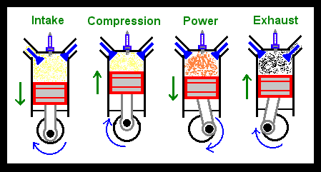
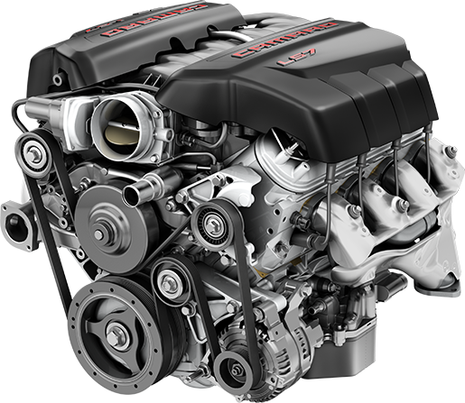
Stored Procedures Basics
ENGINE PROCESS
START CAR ENGINE

Slide 20

Stored Procedures Basics
CALL PROCEDURE
PROCEDURE PROCESS
INSERTS..
UPDATES..
DELETES..
SELECTS..
TRANSACTIONS..

Slide 21
SQL Server – Create Stored Procedures
EmployeeID | ProjectID
1 | 5
1 | 6
2 | 6
2 | 7
2 | 8
Assign projects to employees
If an employee has more than 3 projects throw exception and rollback the changes
Finally, commit the changes

Slide 22
SQL Server – Creating stored procedures
CREATE PROCEDURE udp_AssignProject (@EmployeeID INT, @ProjectID INT)
AS
BEGIN
DECLARE @maxEmployeeProjectsCount INT = 3
DECLARE @employeeProjectsCount INT
SET @employeeProjectsCount = (SELECT COUNT(*)
FROM [dbo].[EmployeesProjects] AS ep
WHERE ep.EmployeeId = @EmployeeID)
BEGIN TRAN
INSERT INTO [dbo].[EmployeesProjects](EmployeeID, ProjectID)
VALUES (@EmployeeID, @ProjectID)
IF(@employeeProjectsCount > @maxEmployeeProjectsCount)
BEGIN
RAISERROR('The employee has too many projects',16,1)
ROLLBACK
END
ELSE
BEGIN
COMMIT
END
END
Procedure Name
Parameters
Variable Declaration and Initialization
Start Transaction
Insert
Throw Exception
Undo Changes
Save Changes

Slide 23
SQL Server – Execute procedure
Parameters
Execute Procedure
EXEC udp_AssignProject 263, 3

Slide 24
MySQL – Create Stored Procedures
EmployeeID | ProjectID
1 | 5
1 | 6
2 | 6
2 | 7
2 | 8
Assign projects to employees
If an employee has more than 3 projects throw exception and rollback the changes
Finally, commit the changes

Slide 25
MySQL – Creating stored procedures
Procedure Name
DELIMITER $$
CREATE PROCEDURE udp_assign_poject(employee_id INT, project_id INT)
BEGIN
DECLARE maxEmployeePorjectsCount INT;
DECLARE employeePorjectsCount INT;
SET maxEmployeePorjectsCount := 3;
SET employeePorjectsCount := (SELECT COUNT(*) FROM employees_projects AS ep
WHERE ep.employee_id = employee_id);
START TRANSACTION;
INSERT INTO employees_projects(employee_id, project_id)
VALUES (employee_id, project_id);
IF (employeePorjectsCount > maxEmployeePorjectsCount) THEN
SIGNAL SQLSTATE '45000' SET MESSAGE_TEXT = 'The employee has too many projects';
ROLLBACK;
ELSE
COMMIT;
END IF;
END $$
Parameters
Variable Declaration and Initialization
Start Transaction
Insert
Throw Exception
Undo Changes
Save Changes

Slide 26
MySQL – Execute stored procedures
Parameters
Execute Procedure
CALL udp_assign_poject(263, 3)

Slide 27

Triggers

Slide 28
What Are Triggers?
Triggers are very much like stored procedures
Called in case of specific event
We do not call triggers explicitly
Triggers are attached to a table
Triggers are fired when a certain SQL statement is executed against the contents of the table
E.g. when a new row is inserted in given table

Slide 29
SQL Server Types of Triggers
After
Instead of
Trigger
Trigger
Event
Event
Event
Notes:
SQL SERVER Types of Triggers
There are two types of triggers
After triggers
Instead-of triggers
After triggers
Fired when the SQL operation has completed and just before committing to the database
Instead-of triggers
Replace the actual database operations
Inside the triggers you can access special tables "inserted" and "deleted" to modify the event.

Slide 30
SQL Server Events
Events
INSERT
UPDATE
DELETE
Notes:
SQL SERVER Types of Triggers
There are two types of triggers
After triggers
Instead-of triggers
After triggers
Fired when the SQL operation has completed and just before committing to the database
Instead-of triggers
Replace the actual database operations
Inside the triggers you can access special tables "inserted" and "deleted" to modify the event.

Slide 31
SQL Server Triggers
EmployeesProjects
EmployeeID | ProjectID
1 | 10
1 | 12
2 | 12
DELETE FROM EmployeesProjects
WHERE EmployeeID = 1
AND ProjectID = 12
EmployeesProjectsHistory
EmployeeID | ProjectID
TRIGGER
1 | 12

Slide 32
SQL Server – Create Trigger
CREATE TRIGGER tr_LogRecords
ON EmployeesProjects
AFTER DELETE
AS
BEGIN
INSERT INTO EmployeesProjectsHistory(EmployeeID, ProjectID)
SELECT d.EmployeeID, d.ProjectID
FROM deleted AS d
END
Trigger Name
Table Name
Trigger Type + Event
Deleted Data
Notes:
Also known as "for-triggers" or just "triggers"
Defined by the keyword FOR

Slide 33
MySQL Types of Triggers
Before
After
Trigger
Trigger
Event
Event
Notes:
There are two types of triggers
After triggers
Before triggers
Key words for getting data inside them are NEW and OLD

Slide 34
MySQL Events
Events
INSERT
UPDATE
DELETE
Notes:
SQL SERVER Types of Triggers
There are two types of triggers
After triggers
Instead-of triggers
After triggers
Fired when the SQL operation has completed and just before committing to the database
Instead-of triggers
Replace the actual database operations
Inside the triggers you can access special tables "inserted" and "deleted" to modify the event.

Slide 35
MySQL Triggers
employees_projects
EmployeeID | ProjectID
1 | 10
1 | 12
2 | 12
DELETE FROM employees_projects
WHERE employee_id = 1
AND project_id = 12
EmployeesProjectsHistory
EmployeeID | ProjectID
TRIGGER
1 | 12

Slide 36
MySQL – Create Trigger
DELIMITER $$
CREATE TRIGGER tr_delete_records
AFTER DELETE
ON employees_projects
FOR EACH ROW
BEGIN
INSERT INTO employees_projects_history
(employee_id, project_id)
VALUES(old.employee_id, old.project_id);
END $$
Trigger Name
Trigger Type + Event
Table Name
Deleted Data

Slide 37

Summary
User defined functions and store procedures save code repetition.
Create triggers that apply a given behavior when some condition has occurred.
Use transactions if we want to be sure that if all the behavior goes as planned
Notes:
We can create user defined functions and store procedures in both MySQL and SQL Server and we can easily execute them to save code repetition.
We can create triggers that apply a given behavior when some condition has occurred.
We can make transactions if we want to be sure that if all the behavior goes as planned, all the changes are made and in the other case, no changes are applied.

Slide 38









Functions, Triggers and Transactions
https://softuni.bg/courses/

Slide 39
License
This course (slides, examples, demos, videos, homework, etc.) is licensed under the "Creative Commons Attribution-NonCommercial-ShareAlike 4.0 International" license
Attribution: this work may contain portions from
"Databases" course by Telerik Academy under CC-BY-NC-SA license

Slide 40





Free Trainings @ Software University
Software University Foundation – softuni.org
Software University – High-Quality Education, Profession and Job for Software Developers
softuni.bg
Software University @ Facebook
facebook.com/SoftwareUniversity
Software University @ YouTube
youtube.com/SoftwareUniversity
Software University Forums – forum.softuni.bg

